Slide 1
Customer Purchase analytics for E-commerce platform

Slide 2
Er dIAGRAM

Slide 3
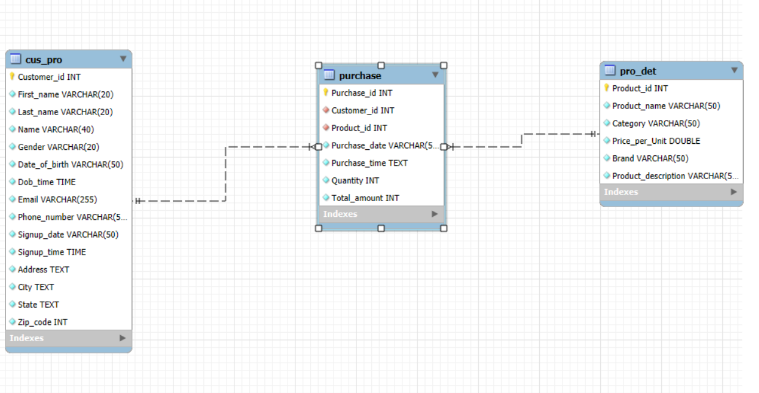

Slide 4
Customer Table

Slide 5

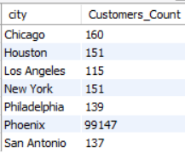

Customers Profile
select count(distinct fp.cus_pro.Customer_id) as Customers_Count from fp.cus_pro
select city, count(distinct fp.cus_pro.Customer_id) as Customers_Count from fp.cus_pro group by city
select Gender, count(distinct fp.cus_pro.Customer_id) as Customers_Count from fp.cus_pro group by Gender

Slide 6
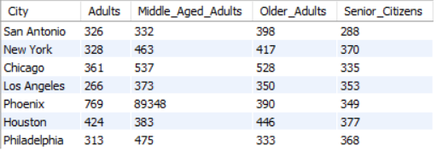
Age Distribution based on cities
Select
fp.cus_pro.City as City,
SUM(CASE WHEN Age_group = 'Adults' THEN 1 ELSE 0 END) AS Adults,
SUM(CASE WHEN Age_group = 'Middle Aged Adults' THEN 1 ELSE 0 END) AS Middle_Aged_Adults,
SUM(CASE WHEN Age_group = 'Older Adults' THEN 1 ELSE 0 END) AS Older_Adults,
SUM(CASE WHEN Age_group = 'Senior Citizens' THEN 1 ELSE 0 END) AS Senior_Citizens
from fp.cus_pro join fp. purchase on
fp.purchase.Customer_id=fp.cus_pro.Customer_id
group by fp.cus_pro.City;

Slide 7
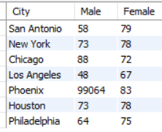
Gender Distribution based on cities
select
fp.cus_pro.City as City,
SUM(CASE WHEN Gender = 'Male' THEN 1 ELSE 0 END) AS Male,
SUM(CASE WHEN Gender = 'Female' THEN 1 ELSE 0 END) AS Female
from fp.cus_pro
group by fp.cus_pro.City;

Slide 8
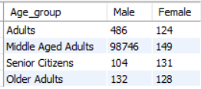
Gender Distribution Based on AGE
select
fp.cus_pro.Age_group as Age_group ,
SUM(CASE WHEN Gender = 'Male' THEN 1 ELSE 0 END) AS Male,
SUM(CASE WHEN Gender = 'Female' THEN 1 ELSE 0 END) AS Female
from fp.cus_pro
group by fp.cus_pro. Age_group ;

Slide 9
Products table

Slide 10

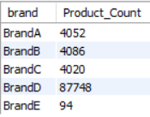
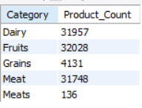
Products Details
select count(distinct fp.pro_det.Product_id) as Product_Count from fp.pro_det;
select brand, count(distinct fp.pro_det.Product_id) as Product_Count from fp.pro_det group by brand
select Category, count(distinct fp.pro_det.Product_id) as Product_Count from fp.pro_det group by Category

Slide 11
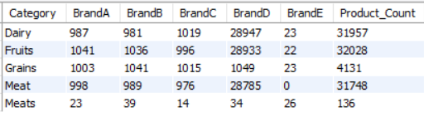
Brand and Category
Select Category,
Sum(case when brand = 'branda' then 1 else 0 end) as branda,
Sum(case when brand = 'brandb' then 1 else 0 end) as brandb,
Sum(case when brand = 'brandc' then 1 else 0 end) as brandc,
Sum(case when brand = 'brandd' then 1 else 0 end) as brandd,
Sum(case when brand = 'brande' then 1 else 0 end) as brande,
count(distinct fp.pro_det.Product_id) as Product_Count
from fp.pro_det
group by Category

Slide 12
Products Performance

Slide 13
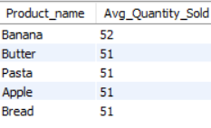
Top 5 Average quantity sold per product
Select
fp.pro_det.Product_name,
round(avg(fp.purchase.Quantity)) as
Avg_Quantity_Sold from
fp.pro_det join fp.purchase on
fp.pro_det.Product_id=fp.purchase.Product_id
group by fp.pro_det.Product_name
order by avg(fp.purchase.Quantity) desc limit 5

Slide 14
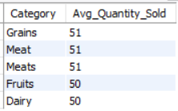
Top 5 Average quantity sold per Category
Select
fp.pro_det.Category,
round(avg(fp.purchase.Quantity)) as
Avg_Quantity_Sold from
fp.pro_det join fp.purchase on
fp.pro_det.Product_id=fp.purchase.Product_id
group by fp.pro_det.Category
order by avg(fp.purchase.Quantity) desc

Slide 15
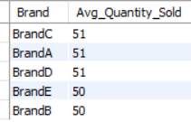
Top 5 Average quantity sold per Brand
Select
fp.pro_det.Brand,
round(avg(fp.purchase.Quantity)) as
Avg_Quantity_Sold from
fp.pro_det join fp.purchase on
fp.pro_det.Product_id=fp.purchase.Product_id
group by fp.pro_det.Brand
order by avg(fp.purchase.Quantity) desc

Slide 16
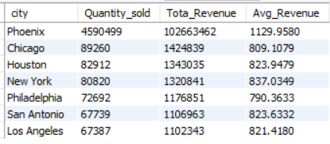
Total Quantity and Revenue by City
Select fp.cus_pro.city,
sum(fp.purchase.Quantity) as Quantity_sold,
sum(fp.purchase.Total_amount) as Tota_Revenue,
Avg(fp.purchase.Total_amount) As Avg_Revenue
from fp.cus_pro join fp.purchase on
fp.cus_pro.Customer_id=fp.purchase.Customer_id
group by city

Slide 17
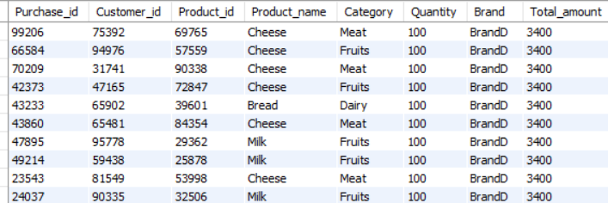
Products and categories yield more profit
SELECT fp.purchase.Purchase_id,
fp.purchase.Customer_id,
fp.purchase.Product_id,
fp.pro_det.Product_name,
fp.pro_det.Category,
fp.purchase.Quantity,
fp.pro_det.Brand,
fp.purchase.Total_amount
FROM fp.purchase join fp.pro_det on
fp.purchase.Product_id=fp.pro_det.Product_id
order by fp.purchase.Total_amount desc

Slide 18
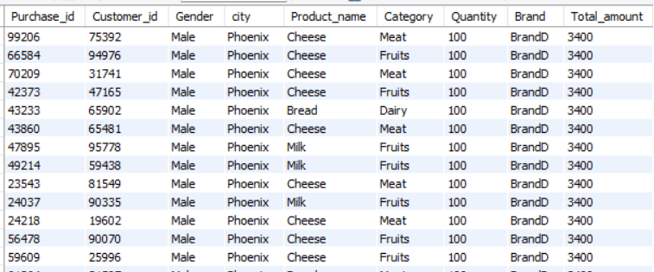
Products and categories yield more profit with customer details
SELECT fp.purchase.Purchase_id,
fp.purchase.Customer_id,
fp.cus_pro.Gender,
fp.cus_pro.city,
fp.pro_det.Product_name,
fp.pro_det.Category,
fp.purchase.Quantity,
fp.pro_det.Brand,
fp.purchase.Total_amount
FROM fp.purchase join fp.pro_det on
fp.purchase.Product_id=fp.pro_det.Product_id
join fp.cus_pro on
fp.purchase.Customer_id=fp.cus_pro.Customer_id
order by fp.purchase.Total_amount desc

Slide 19
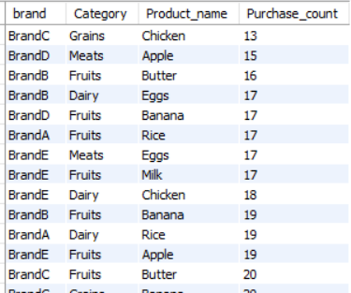
Purchase Count by Product brand and Category
Select fp.Pro_det.Brand, fp.Pro_det.Category,
Fp.Pro_det.Product_name,
Count(fp.Purchase.Purchase_id) as purchase_count
From fp.Pro_det join fp.Purchase on
Fp.Pro_det.Product_id=fp.Purchase.Product_id
Group by fp.Pro_det.Product_name,
Fp.Pro_det.Brand,fp.Pro_det.Category;

Slide 20
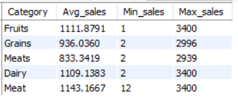
average, Minimum and Maximum Sales based on product category
select
fp.pro_det.Category,
avg(fp.purchase.total_amount) as Avg_sales,
min(fp.purchase.total_amount) as Min_sales,
max(fp.purchase.total_amount) as Max_sales
from fp.purchase join fp.pro_det on
fp.purchase.Product_id=fp.pro_det.Product_id
group by fp.pro_det.Category;

Slide 21
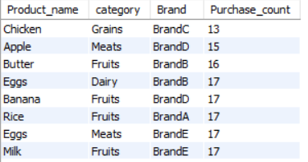
Purchase count for each product category and Brand
Select
fp.pro_det.Product_name,
fp.pro_det.category,
fp.pro_det.Brand,
count(fp.purchase.Product_id) as Purchase_count
from fp.pro_det join fp.purchase on
fp.pro_det.Product_id=fp.purchase.Product_id
group by fp.pro_det.Product_name, fp.pro_det.category,fp.pro_det.Brand
order by count(fp.purchase.Product_id) asc;

Slide 22
Analysis on Time

Slide 23
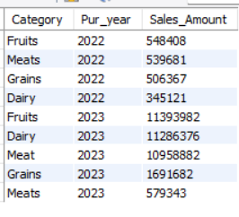
Cumulative sales of each category on every year
SELECT fp.pro_det.category as Category,
YEAR(fp.purchase.purchase_date) as Pur_year,
sum(fp.purchase.Total_amount) as Sales_Amount
FROM fp.purchase join fp.pro_det
on fp.purchase.Product_id =fp.pro_det.Product_id
group by Pur_year,Category
order by Pur_year,Sales_Amount desc

Slide 24
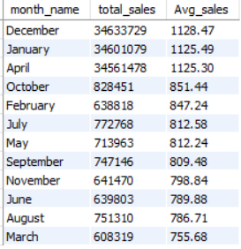
Monthly Sales
SELECT
MONTHNAME(purchase_date) AS month_name,
SUM(Total_amount) AS total_sales,
ROUND(AVG(Total_amount), 2) AS Avg_sales
FROM fp.purchase
GROUP BY month_name
ORDER BY Avg_sales desc;

Slide 25
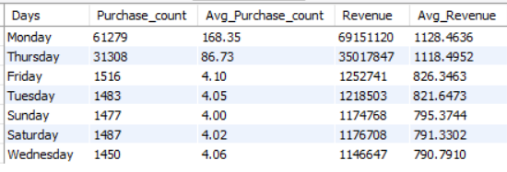
Revenue based on Days
Select
Dayname(purchase_date) as days,
Count(purchase_id) as purchase_count,
Round(count(*) / count(distinct date(purchase_date)), 2) as avg_purchase_count,
Sum(fp.Purchase.Total_amount) as revenue,
Avg(fp.Purchase.Total_amount) as avg_revenue
From fp.Purchase
WHERE purchase_date IS NOT NULL
GROUP BY days
Order by avg(fp.Purchase.Total_amount) desc;

Slide 26
Customer Demographics

Slide 27
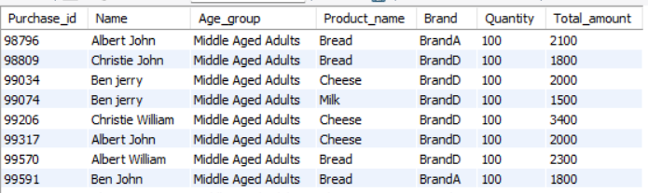
Purchase details with Customer details
Select fp.purchase.Purchase_id,
fp.cus_pro.Name,
fp.cus_pro.Age_group,
fp.pro_det.Product_name,
fp.pro_det.Brand,
fp.purchase.Quantity,
fp.purchase.Total_amount
from fp.purchase join fp.cus_pro on
fp.purchase.Customer_id=fp.cus_pro.Customer_id
join fp.pro_det on
fp.purchase.Product_id=fp.pro_det.Product_id
where fp.cus_pro.age>30
order by fp.purchase.Quantity desc;

Slide 28
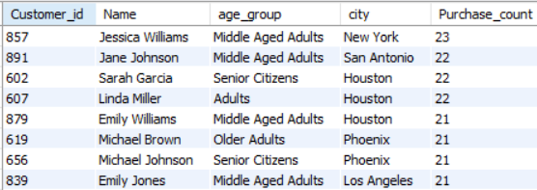
Top 50 customers based on purchase count
Select
fp.cus_pro.Customer_id,
fp.cus_pro.Name,
fp.cus_pro.age_group,
fp.cus_pro.city,
count(fp.purchase.Purchase_id) as Purchase_count
from fp.cus_pro join fp.purchase on
fp.cus_pro.Customer_id=fp.purchase.Customer_id
group by fp.cus_pro.Customer_id, fp.cus_pro.Name,fp.cus_pro.age_group,fp.cus_pro.city
order by count(fp.purchase.Purchase_id) desc limit 50;

Slide 29
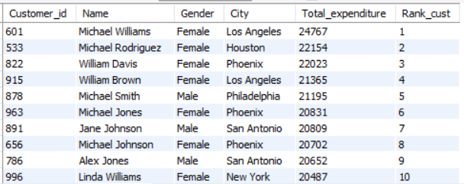
Top 10 Customers based on total expenditure
SELECT fp.cus_pro.Customer_id,
fp.cus_pro.Name,
fp.cus_pro.Gender,
fp.cus_pro.City,
sum(fp.purchase.Total_amount) as Total_expenditure,
dense_rank()over(order by sum(fp.purchase.Total_amount) desc) as Rank_cust
from fp.cus_pro join fp.purchase
on fp.cus_pro.Customer_id =fp.purchase.Customer_id
group by fp.cus_pro.Customer_id, fp.cus_pro.Name, fp.cus_pro.Gender,fp.cus_pro.City
order by Total_expenditure desc limit 10

Slide 30
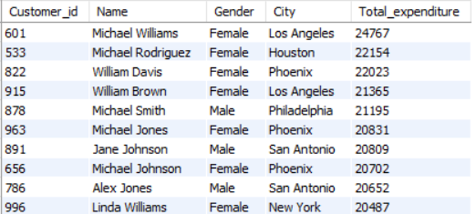
Customers total expenditure
SELECT fp.cus_pro.Customer_id,
fp.cus_pro.Name,
fp.cus_pro.Gender,
fp.cus_pro.City,
sum(fp.purchase.Total_amount) as Total_expenditure
from fp.cus_pro join fp.purchase
on fp.cus_pro.Customer_id =fp.purchase.Customer_id
group by fp.cus_pro.Customer_id,
fp.cus_pro.Name,fp.cus_pro.Gender,fp.cus_pro.City
order by Total_expenditure desc

Slide 31

Percentage OF REPEATED CUSTOMERS
WITH customer_purchase_counts AS(
SELECT Customer_id,
COUNT(*) AS purchase_count
FROM fp.purchase
GROUP BY Customer_id)
SELECT
ROUND(100.0 * SUM
(CASE WHEN purchase_count > 1 THEN 1 ELSE 0 END) / COUNT(*), 2)
AS repeat_customer_percentage
FROM customer_purchase_counts;

Slide 32
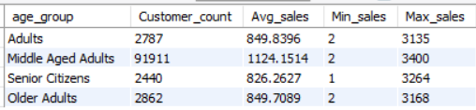
average, Minimum and Maximum Sales based on Age category
select fp.cus_pro.age_group,
count(cus_pro.age_group) as Customer_count,
avg(fp.purchase.total_amount) as Avg_sales,
min(fp.purchase.total_amount) as Min_sales,
max(fp.purchase.total_amount) as Max_sales
from fp.purchase join fp.cus_pro on
fp.purchase.Customer_id=fp.cus_pro.Customer_id
group by fp.cus_pro.age_group;

Slide 33
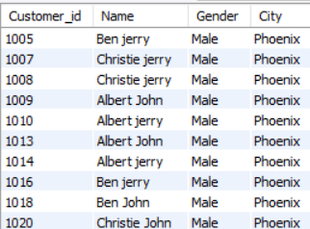
Inactive customers
SELECT fp.cus_pro.Customer_id,
fp.cus_pro.Name,
fp.cus_pro.Gender,
fp.cus_pro.City
from fp.cus_pro
where fp.cus_pro.Customer_id
not in (select fp.purchase.customer_id from fp.purchase)
Total count: 40,122

Slide 34
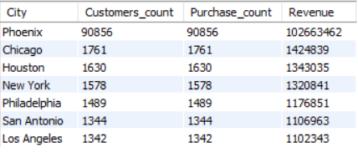
Revenue based on City
select
fp.cus_pro.City as City,
count(fp.cus_pro.customer_id) as Customers_count,
count(fp.purchase.Purchase_id) as Purchase_count,
sum(fp.purchase.total_amount) as Revenue
from fp.cus_pro join fp. purchase on
fp.purchase.Customer_id=fp.cus_pro.Customer_id
group by fp.cus_pro.City
Order by Revenue desc ;

Slide 35

Top 3 cities with more unique customers
Select
fp.cus_pro.City,
Count(distinct fp.cus_pro.Customer_id) as Unique_customers
from fp.cus_pro join fp.purchase
on fp.cus_pro.Customer_id = fp.purchase.Customer_id
group by fp.cus_pro.city
order by Unique_customers desc limit 3;

Slide 36


